Slide 1




Data Science Project Management
Presented By
Group 2

Slide 2


Problem Statement
The goal of this project is to construct a Convolutional Neural Network (CNN) to categorise photographs of clothing as "Real" or "Fake." The dataset includes grayscale pictures of several outfits, and the objective is to discern between genuine and fake goods with accuracy.

Slide 3
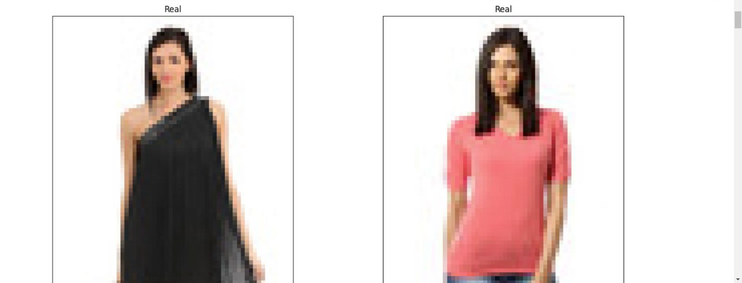

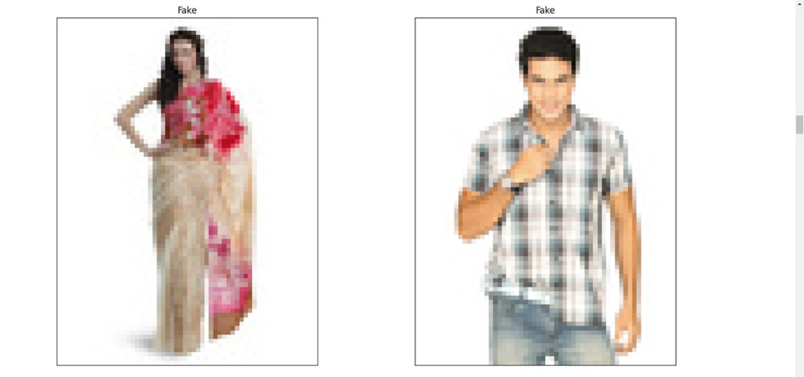
Real Images :
Fake Images :

Slide 4
Using the training generator, the CNN model is trained on the preprocessed dataset. To avoid overfitting, a callback with an early stopping is used. Several metrics, including accuracy, precision, recall, and area under the curve (AUC), are used to assess the model's performance.

Slide 5
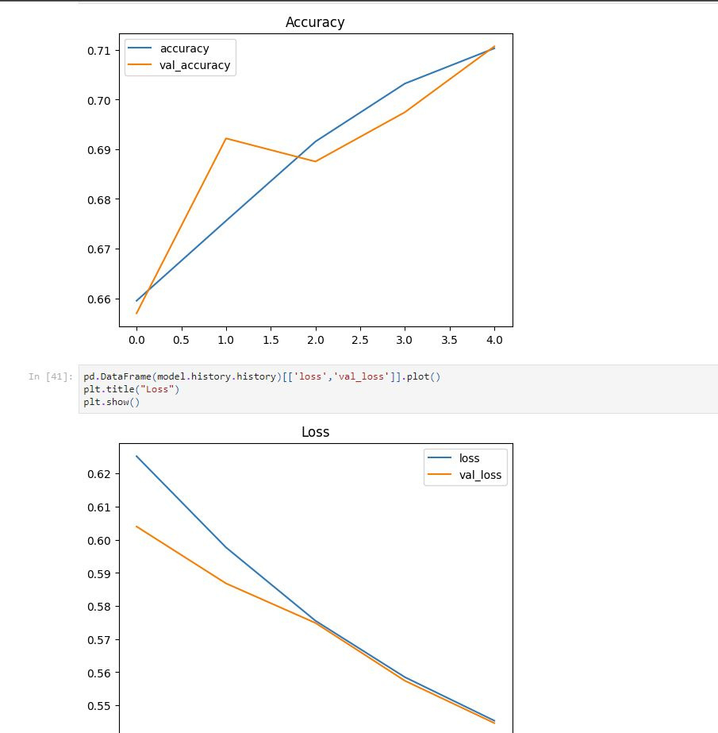
Results:

Slide 6
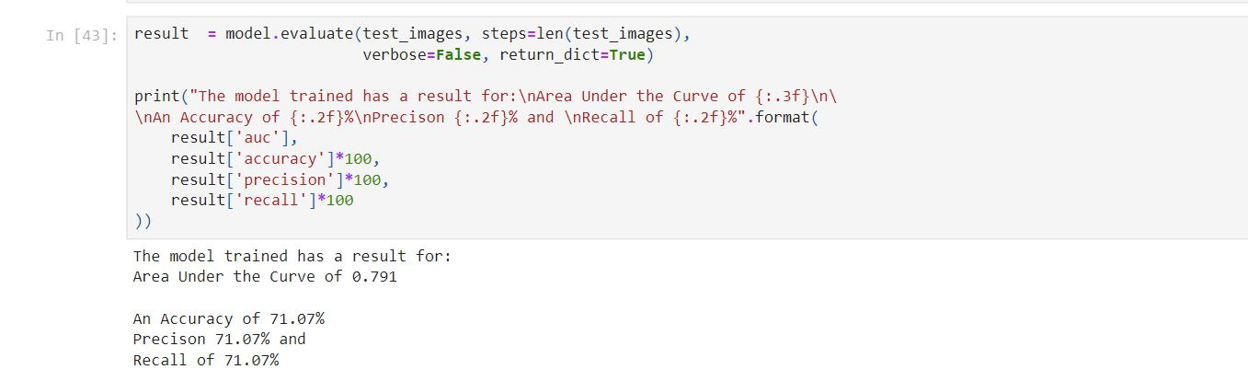
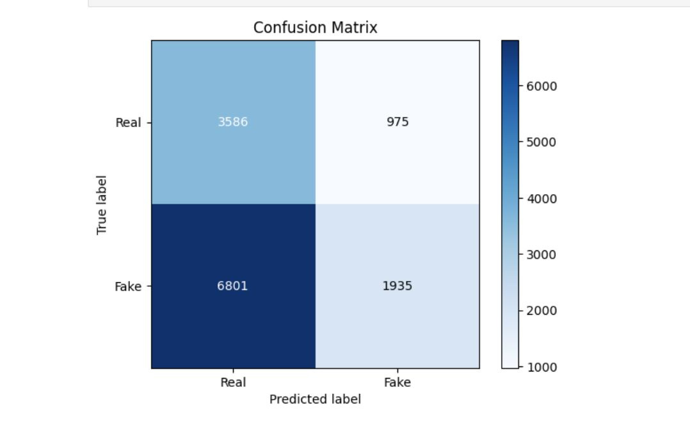
Results:

Slide 7
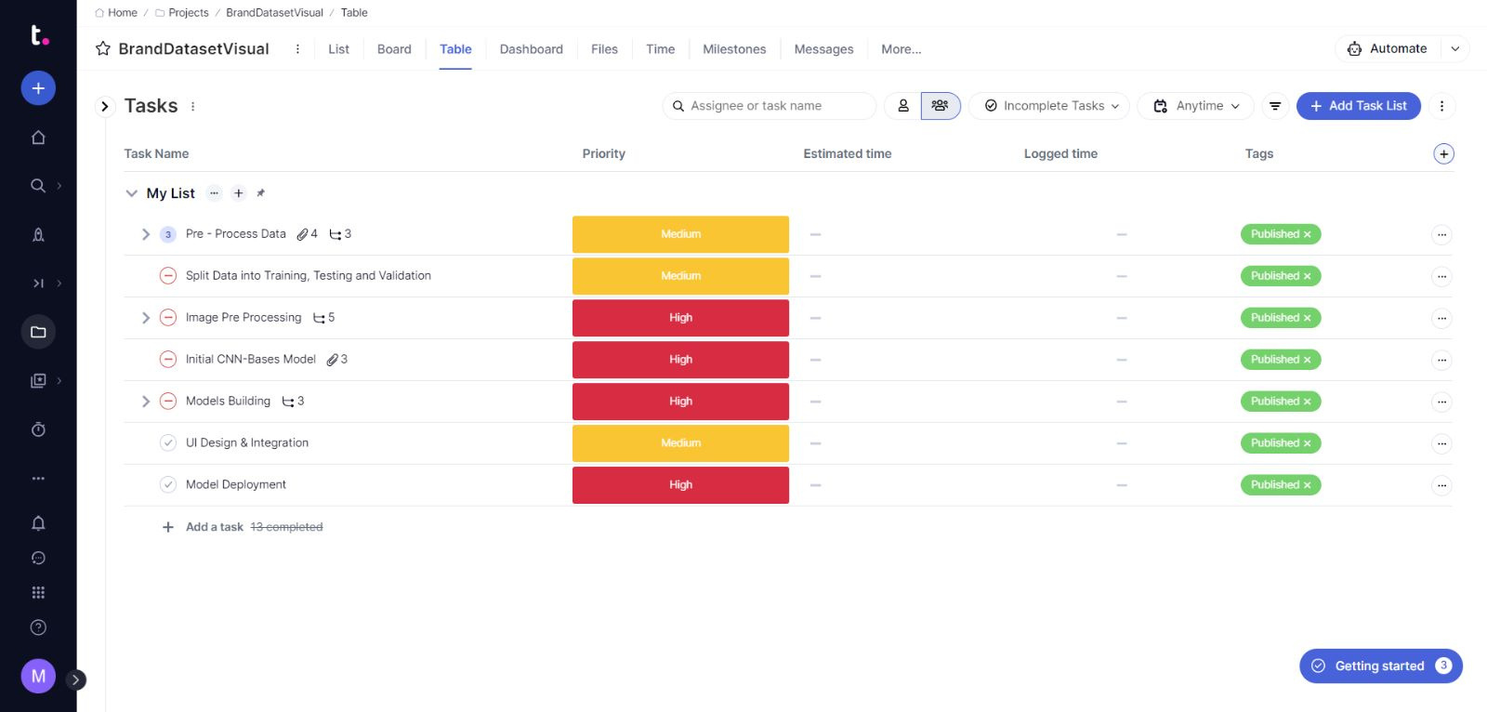
Project Dashboard
https://ahmadscompany38.eu.teamwork.com/app/projects/564674/tasks/table

Slide 8

Milestones

Slide 9

Github Repository
https://github.com/Tonyrj/Data-Science

Slide 10

Github Repository

Slide 11
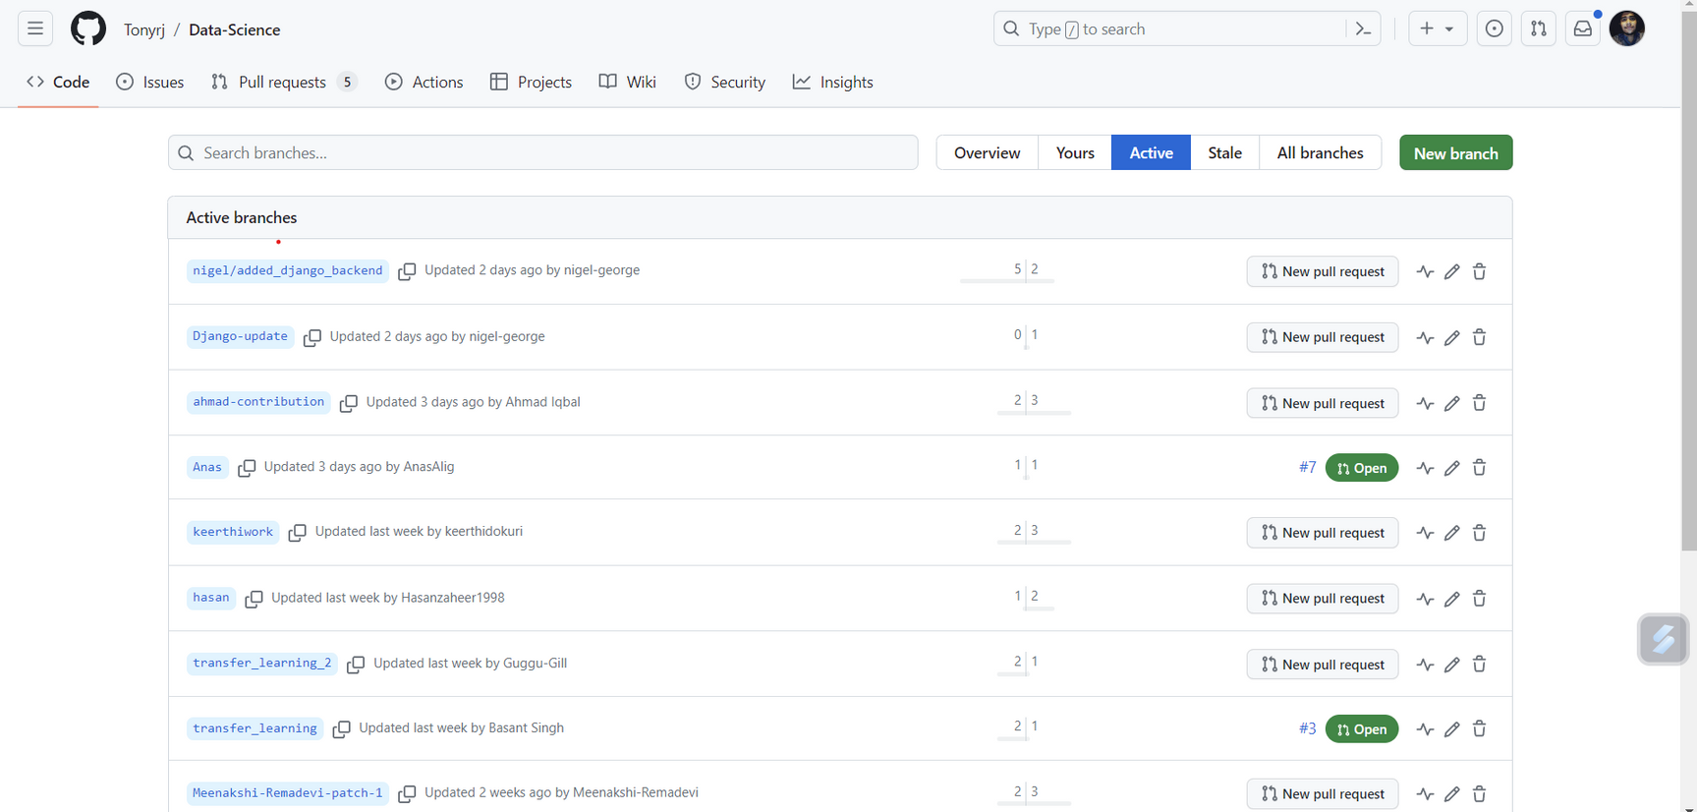
Github Repository

Slide 12

Front End

Slide 13

Front End

Slide 14
Thank You

